Slide 1
Feature engineering
-by
M . Sai Raj

Slide 2
Feature engineering:
Feature engineering is the most important technique used in creating machine learning models.
Feature Engineering is a basic term used to cover many operations that are performed on the variables(features) to fit them into the algorithm
.
It helps in increasing the accuracy of the model there by enhances the results of the predictions.
Feature Engineered machine learning models perform better on
data than basic machine learning models.

Slide 3
Imputation technique:
Most machine learning algorithms require numeric input values, and a value to be present for each row and column in a dataset.
As such, it is common to identify missing values in a dataset and replace them with a numeric value
we will substitute the missing values by using mean , median, or mode values.

Slide 4
Feature encoding:
It is the process of transforming a categorical variable into a continuous variable and using them in the model then it is called as feature encoding.
machine learning models cannot handle the text data
directly.

Slide 5
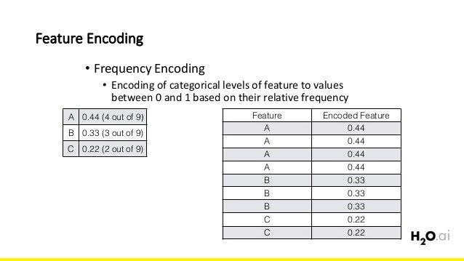

Slide 6
Types of feature encoding:
Label encoding
one hot encoding
1. Label encoding:
Label encoding converts the lables into numeric form so as to convert
It into the machine readable form .
Machine learning algorithms can then decide in a better way on those
Labes must be operated.

Slide 7
One hot encoding:
To over come the disadvantage of label encoding ,we can use one hot
Encoding .
1. splitting of categories to different columns.
2. And we will put 0’s for null values and 1’s as an indicator for the
Appropriate column.

